Slide 1

Digital Image Processing
Unit I – Digital Image Fundamentals

Slide 2
Unit I – Contents
Introduction,
Origin,
Steps in Digital Image Processing,
Components,
Elements of Visual Perception,
Image Sensing and Acquisition,
Image Sampling and Quantization,
Relationships between pixels, colour models.

Slide 3
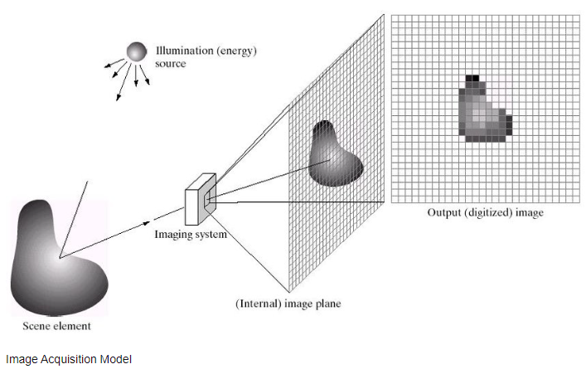
Basics
Image: An image is a visual representation of an object.
Image: An image is a projection of a 3- D scene into a 2D projection plane.
Digital Image: Binary representation of visual data.
Image ( CSE) : A picture composed of an array of elements called pixels.
Pixel: Pixels are the smallest unit in an image. Up to millions of pixels make up an image or video on a device's screen. Each pixel comprises a subpixel that emits a red, green and blue (RGB) color, which displays at different intensities.

Slide 4
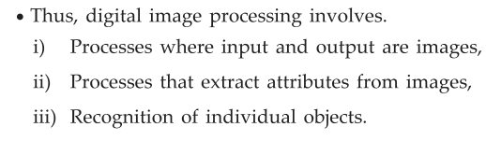
What is Digital Image Processing ?
It is the manipulation of the digital data with the help of computer hardware and software to produce digital maps in which the specific information has been extracted and highlighted.
Why we need Digital Image Processing ?
To record and store images
To enhance images using mathematics
To analysis images
To synthesize images
To create computer vision systems

Slide 5
Image basics
Images are two types
1. Analog Image: Ex: Image on CRT monitor
(x,y,f) are continuous range values
Fast processing
2. Digital image: (x,y,f) are Finite , Discrete range values
Adv: Efficient storage and manipulations
Disadv: Required High storage space, Fast processors required

Slide 6
Types of Images
Types of Domains to process: 1. Frequency domain 2. Spatial domain
Types of Images:
Binary Image – The binary image contains only two-pixel elements 0 & 1.
Here, 0 refers to black and 1 refers to white. This is also known as Monochrome.
Black and White Image– The image contains black and white color.
8 Bit Color Format – It has 256 different shades of colors and known as Grayscale Image. In this format, 0 stands for Black, and 255 stands for white, and 127 stands for Gray.
16 Bit Color Format – It has different colors and is known as a High Color Format. The distribution of Color is not the same as a Grayscale image.

Slide 7
Introduction
manipulation of multidimensional signals
image (photo) f (x, y)
Video f (x, y,t)
CT, MRI (x, y, z,t)
An image may be defined as a two-dimensional function f(x,y),
where x and y are spatial (plane) coordinates,
and the amplitude to f at any pair of coordinates (x,y) is called the intensity of the image at that point.
Pixel: element of an image
The term gray level is used often to refer to the intensity of monochrome images.
Color images are formed by a combination of individual 2-D images. For example, the RGB color system, a color image consists of three (red, green and blue) individual component images. For this reason, many of the techniques developed for monochrome images can be extended to color images by processing the three component images individually.
An image may be continuous with respect to the x- and y- coordinates and also in amplitude. Converting such an image to digital form requires that the coordinates, as well as the amplitude, be digitized.

Slide 8
Image file formats
A digital image is often encoded in the form of binary files for
the purpose of storage and transmission.
Whatever be the format, the image file consists of two parts:
(i) file header, and (ii) image data.
The common image file formats are
GIF (Graphics Interchange Format),
JPEG (Joint Photographic Expert Group),
PNG (Portable Network Graphics),
TIFF (Tagged Image File Format),
PSD file format, and
EPS

Slide 9
DIP Applications
Digital image processing has a broad spectrum of applications, such as
Remote sensing via satellites and other spacecrafts
Image transmission and storage for business applications
Medical processing
RADAR (Radio Detection and Ranging)
SONAR (Sound Navigation and Ranging)
Acoustic Image Processing (The study of underwater sound is known as Underwater Acousticsor Hydro Acoustics)
Robotics and automated inspection of industrial parts Images acquired by satellites are useful in tracking of
Earth resources
Geographical mapping
Prediction of agricultural crops
Urban growth and weather monitoring
Flood and fire control and many other environmental applications Space image applications include:

Slide 10
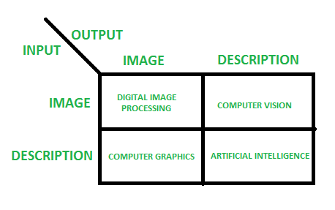
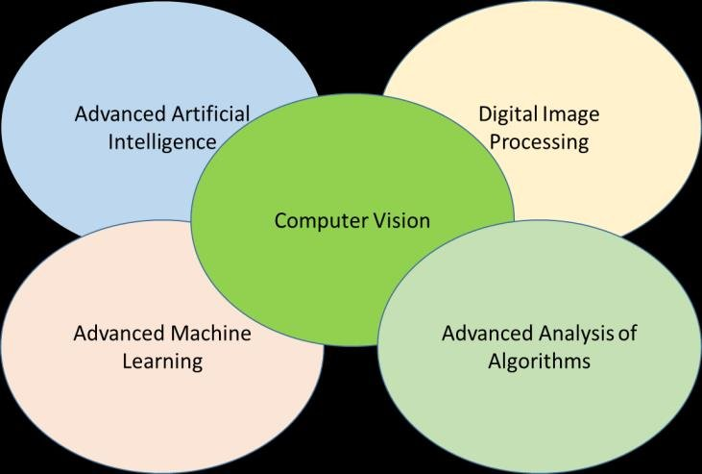
Types of processing image
There are three types of computerized processes in the processing of image
Low level Process: These involve primitive operations such as image processing to reduce noise, contrast enhancement and image sharpening. These kinds of processes are characterized by fact the both inputs and output are images.
low-level: inputs and outputs are images
Mid-level Image Processing: It involves tasks like segmentation, description of those objects to reduce them to a form suitable for computer processing, and classification of individual objects. The inputs to the process are generally images but outputs are attributes extracted from images.
mid-level: outputs are attributes extracted from input images
High level Processing: It involves “making sense” of an ensemble of recognized objects, as in image analysis, and performing the cognitive functions normally associated with vision.
high-level: an ensemble of recognition of individual objects

Slide 11
Origins of Digital Image Processing

Slide 12
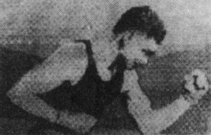
History of Digital Image Processing
Early 1920s: One of the first applications of digital imaging was in the news-paper industry
The Bartlane cable picture transmission service
Images were transferred by submarine cable between London and New York
Pictures were coded for cable transfer and reconstructed at the receiving end on a telegraph printer
5 discrete intensity values

Slide 13
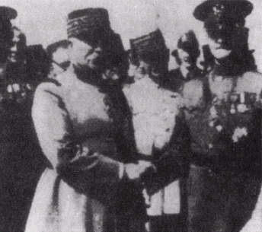
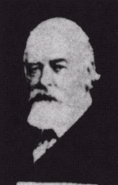
History of DIP (cont…)
Mid to late 1920s: Improvements to the Bartlane system resulted in higher quality images
New reproduction processes based on photographic techniques
Increased number of tones in
reproduced images
Improved 5 to 15 intensity values
Improved
digital image Early 15 tone digital image

Slide 14
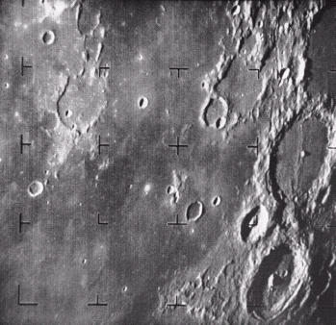
History of DIP (cont…)
1960s: Improvements in computing technology and the onset of the space race led to a surge of work in digital image processing
1964: Computers used to improve the quality of images of the moon taken by the Ranger 7 probe
Such techniques were used in other space missions
including the Apollo landings
A picture of the moon taken by the Ranger 7 probe minutes before landing

Slide 15
Computer era
1940: introduced Digital computer
1948: Introduced transistor in Bell lab
1950-60: High level languages
1958: IC s introduced
1960: Developed Operating systems
1970:Microprocessor
1981: Personal computer by IBM

Slide 16
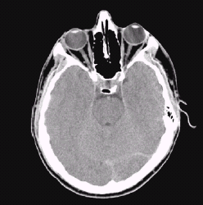

History of DIP (cont…)
1970s: Digital image processing begins to be used in medical applications
– 1979: Sir Godfrey N. Hounsfield & Prof. Allan M. Cormack share the Nobel Prize in medicine for the invention of tomography, the technology behind Computerised Axial
Tomography (CAT) scans
Typical head slice CAT image

Slide 17
History of DIP (cont…)
1980s - Today: The use of digital image processing techniques has exploded and they are now used for all kinds of tasks in all kinds of areas
Image enhancement/restoration
Artistic effects
Medical visualisation
Industrial inspection
Law enforcement
Human computer interfaces

Slide 18
History of DIP (cont…)
1980s - Today: The use of digital image processing techniques has exploded and they are now used for all kinds of tasks in all kinds of areas
Image enhancement/restoration
Artistic effects
Medical visualisation
Industrial inspection
Law enforcement
Human computer interfaces

Slide 19
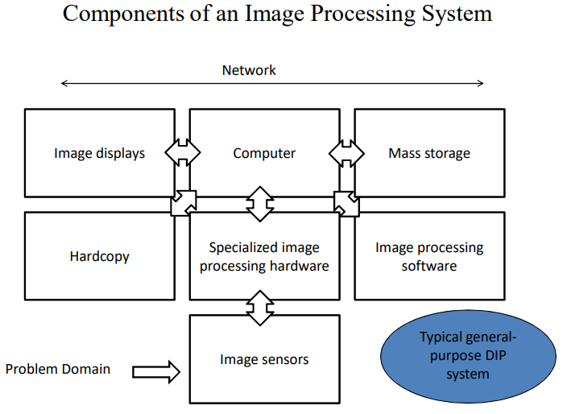

Slide 20
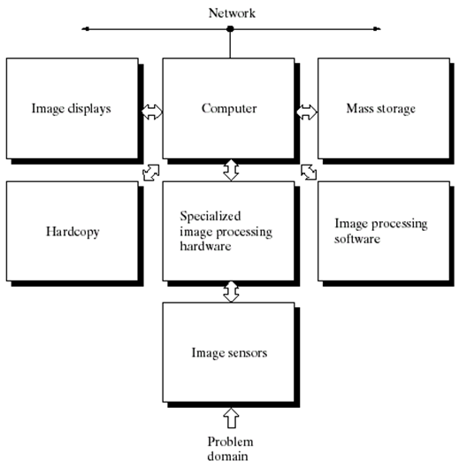
Components of an Image Processing System
Image compression
Short term storage– computer memory – during processing
Online storage – frame buffers – fast recall
Archival storage –infrequent use
Storage measured in bytes, kilo, mega, giga and tera bytes
Default function in computers to process image
Optical fiber and broad band technologies are good
Color TV monitors
Monitors are driven by o/ps of images or graphic display cards
General purpose pc to super computer
Laser printers
Film cameras
Heat sensitive devices(fascimie)
Optical devices
)CD ROM , DVD ram disks)
Specialized hardware modules to perform specific tasks based on programs
Sophisticated software allows integration of modules and general purpose commands from at least on computer lang
Digitizer – converts sensed images into digital format
Hardware circuitry to perform Arithmetic and logical operations On image
The hardware is often called front end system
Gives fast o/ps
Physical device –senses the energy radiated from object
Light energy is converted into electrical energy

Slide 21
Elements in Image Processing System
1)image sensor
Two elements are required to acquire digital images.
●
The first is a physical device that is sensitive to the energy radiated by the object we wish to image.
●
The second, called a digitizer, is a device for converting the output of
the physical sensing device into digital form.
Eg: in a digital video camera, the sensors produce an electrical output proportional to light intensity. The digitizer converts these outputs to
digital data

Slide 22
Elements in Image Processing System
2)Specialized image processing hardware
usually consists of
the digitizer
●
2) hardware that performs other primitive operations, such as an
arithmetic logic unit (ALU),
●
ALU performs arithmetic and logical operations in parallel on
entire images.
Eg ALU is used in averaging images as quickly as they are digitized, for the purpose of noise reduction.
This type of hardware sometimes is called a front-end subsystem,
Its most distinguishing characteristic is speed.
This unit performs functions that require fast data throughputs (e.g., digitizing and averaging video images at 30 frames) that the typical main computer cannot handle.
●
●
●
●

Slide 23
Elements in Image Processing System
3)Computer
The computer in an image processing system is a general-purpose computer
Can range from a PC to a supercomputer.
In dedicated applications, some times specially designed computers are
●
●
used to achieve a required level of performance,
●
our interest here is on general-purpose image processing systems.
●
In these systems, almost any well-equipped PC-type machine is
suitable for offline image processing tasks.

Slide 24
Elements in Image Processing System
4)Software for image procesing
The Software for image processing consists of specialized modules that perform specific tasks.
●
A well-designed package also includes the capability for the user to write code that, as a minimum, utilizes the specialized modules.
●
More sophisticated software packages allow the integration of those modules
and general-purpose software commands from at least one computer language

Slide 25
Elements in Image Processing System
5)Mass Storage
The Mass storage capability is a must in image processing applications.
An image of size 1024*1024 pixels, in which the intensity of each pixel is an 8- bit quantity, requires one megabyte of storage space if the image is not compressed.
Storage is measured in bytes (eight bits),
HDDs, DVDs, HD-DVDs, BDs, flash drives etc.
Kbytes (one thousand bytes- storage hardware size, data transfer rates, clock
speeds, operations per second, (For RAM , OS ,1 KB=1024 bytes =2¹⁰)),
Mbytes (one million bytes- storage hardware size, data transfer rates, clock speeds, operations per second, (For RAM, OS, 1024 Kbytes = 2²⁰))
Gbytes (meaning giga, or one billion, bytes - storage hardware size, data transfer rates, clock speeds, operations per second, (For RAM, OS, 1024 MegaBytes =2³⁰ ))
Tbytes (meaning tera, or one trillion, bytes - storage hardware size, data transfer rates, clock speeds, operations per second, (For RAM, OS, 1024
GBytes=2⁴⁰)).

Slide 26
Elements in Image Processing System
5)Mass Storage
The Digital storage for image processing applications falls into three principal categories:
(1) short-term storage for use during processing,
●
a)computer memory.
●
b) by specialize
d boards, called frame buffers, that store one or
more images and can be accessed rapidly, usually at video rates (e.g., at 30 complete images per second).
●
The latter method allows virtually instantaneous image zoom, as well as scroll (vertical shifts) and pan (horizontal shifts).
Frame buffers usually are housed in the specialized image processing hardware unit .
●

Slide 27
Elements in Image Processing System
5)Mass Storage
(2) on-line storage for relatively fast re-call,
The key factor characterizing on-line storage is frequent access to the stored data.
●
●
Online storage generally takes the form of magnetic disks or
optic
al-media storage
●
(3) archival storage, characterized by infrequent access.
●
archival storage is characterized by massive storage requirements
infrequent need for access.
●
Magnetic tapes and optical disks housed in “jukeboxes” are the usual
media for archival applications.

Slide 28
Elements in Image Processing System
6)Image displays
Image displays in use today are mainly color (preferably flat screen) TV monitors.
Monitors are driven by the outputs of image and graphics display cards that are an integral part of the computer system.
●
Display cards available commercially as part of the computer system.
●
In some cases, it is necessary to have stereo displays,
●
These are implemented in the form of headgear containing two small displays embedded in goggles worn by the user.

Slide 29
Elements in Image Processing System
7) Hardcopy devices
Hardcopy devices for recording images include
laser printers, film cameras,
heat-sensitive devices,
●
●
●
●
inkjet units,
●
digital units, such as optical and CD-ROM disks.
●
Film provides the highest possible resolution, but paper is the obvious medium of choice for written material.
For presentations, images are displayed on film transparencies or in a digital medium if image projection equipment is used.
The latter approach is gaining acceptance as the standard for image presentations.
●
●

Slide 30
Elements in Image Processing System
8) Network
Networking is almost a default function in any computer system in use today.
large amount of data inherent in image processing applications
●
Therefore the key consideration in image transmission is bandwidth.
●
In dedicated networks, this typically is not a problem
●
communications with remote sites via the Internet are not always as efficient.
●
Fortunately, this situation is improving quickly as a result of optical fiber and other broadband technologies.

Slide 31
Fundamental Steps in DIP

Slide 32
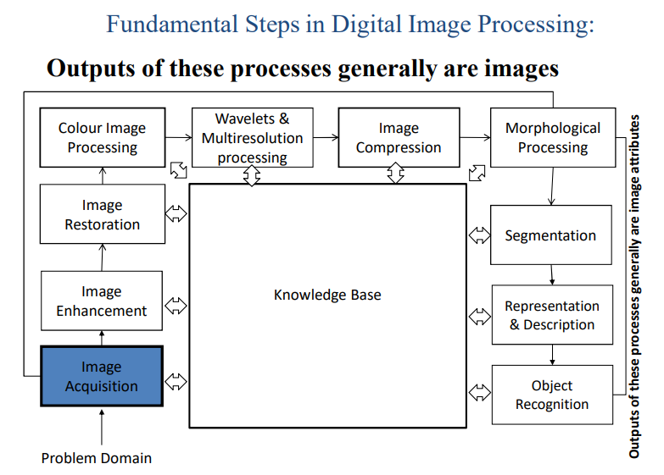

Slide 33
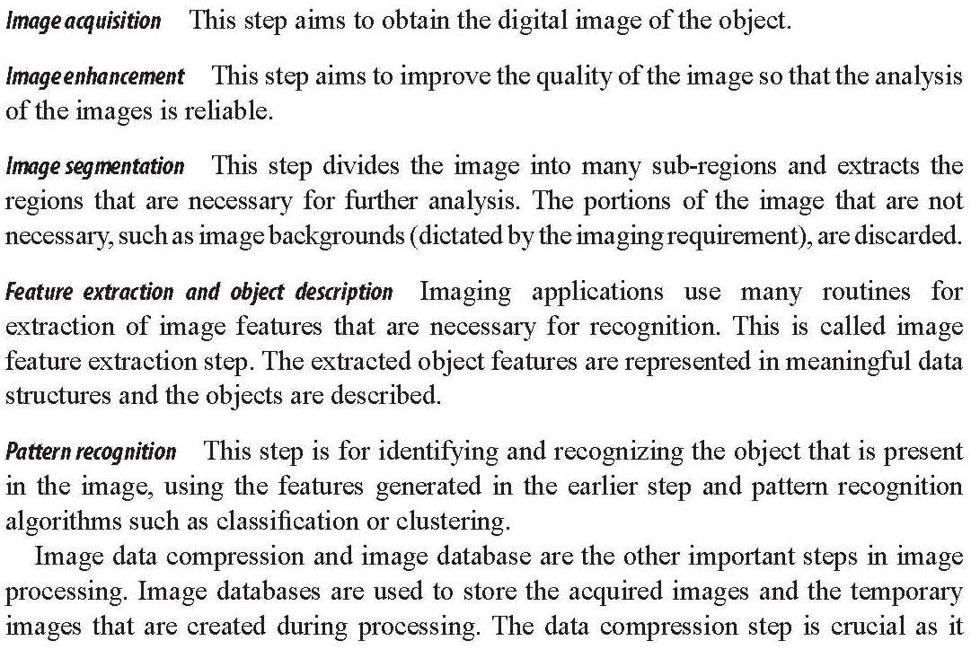

Slide 34
Fundamental steps
Image Restoration: It deals with improving the appearance of an image. It is an objective approach, in the sense that restoration techniques tend to be based on mathematical or probabilistic models of image processing. Enhancement, on the other hand is based on human subjective preferences
Color Image Processing: It is an area that is been gaining importance because of the use of digital images over the internet. Color image processing deals with basically color models and their implementation in image processing applications.
Wavelets and Multi resolution Processing: These are the foundation for representing image in various degrees of resolution.
Compression: It deals with techniques reducing the storage required to save an image, or the bandwidth required to transmit it over the network. It has to major approaches
Lossless Compression
2. Lossy Compression

Slide 35
Fundamental steps
Morphological Processing: It deals with tools for extracting image components that are useful in the representation and description of shape and boundary of objects. It is majorly used in automated inspection applications.
Representation and Description: It always follows the output of segmentation step that is, raw pixel data, constituting either the boundary of an image or points in the region itself. In either case converting the data to a form suitable for computer processing is necessary.
Recognition: It is the process that assigns label to an object based on its descriptors. It is the last step of image processing which use artificial intelligence of software.
Knowledge Base: Knowledge about a problem domain is coded into an image processing system in the form of a knowledge base. This knowledge may be as simple as detailing regions of an image where the information of the interest in known to be located. Thus, limiting search that has to be conducted in seeking the information.

Slide 36
Image Sensing and Acquisition

Slide 37

IMAGE ACQUISITION PROCESS
Illumination energy
- Light energy falls on an object
Source element
- it gets illuminated due to
light energy
Imaging system
- captures reflected light
- converts light energy into
electrical energy which is
continuous in nature
- consists digitizer which
converts analog signal to
digital form

Slide 38
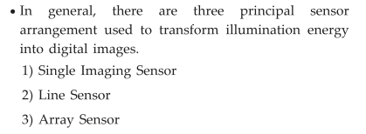
Image Sensing and Acquisition
To generate an image we need EM source and a sensor that can detect the energy reflected from the object .
The process of image sensing is called as image acquisition.
.

Slide 39
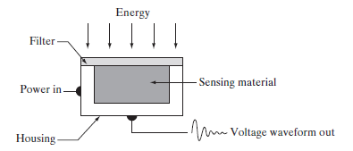
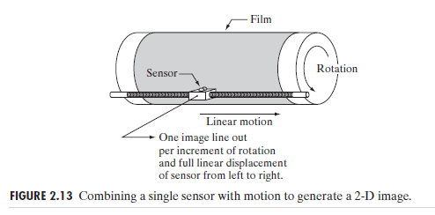
Image Acquisition Using a Single Sensor
Incoming energy is transformed into a voltage by the combination of input electrical power and sensor .The output voltage waveform is the response of the sensor(s).
This method
is an inexpensive
(but slow) way to
obtain high-resolution
images .

Slide 40
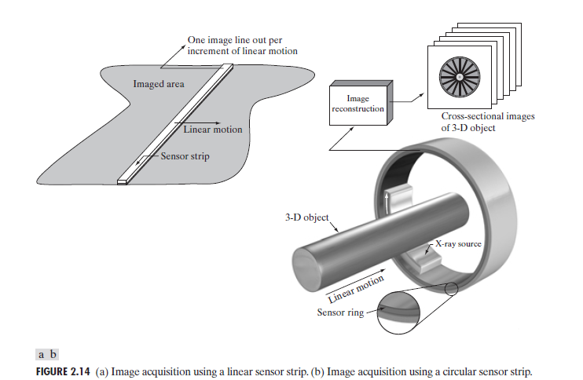
Image Acquisition Using Sensor Strips( Line sensor)
Fig: Line sensor
Used in airborne imaging
Notes:
Number of single sensors have been arranged linearly in-line to form a strip as shown in above fig. The strip provides imaging elements in one direction. Motion perpendicular to the strip provides imaging in the other direction, as shown in Fig. 2.14(a).
Sensor strips mounted in a ring configuration are used in medical and industrial imaging to obtain cross-sectional (“slice”) images of 3-D objects, as Fig. 2.14(b) shows. A rotating X-ray source provides illumination and the sensors opposite the source collect the X-ray energy that passes through the object (the sensors obviously have to be sensitive to X-ray energy). This is the basis for medical and industrial computerized axial tomography (CAT) imaging, magnetic resonance imaging (MRI) and positron emission tomography (PET).
the output of the sensors must be processed by reconstruction algorithms whose objective is to transform the sensed data into meaningful cross-sectional images .

Slide 41
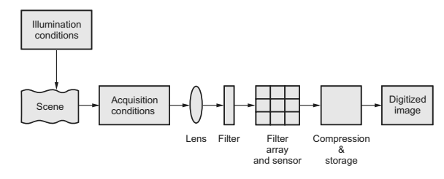
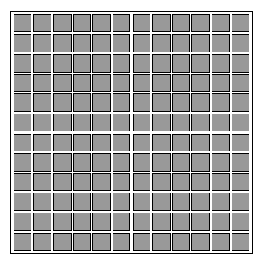
Image Acquisition Using Sensor Arrays
Fig : Array sensor
Used in digital cameras. A typical sensor for these cameras is a CCD array.
In this type of sensor ,uses 4000x4000 elements or more as shown above.
The response of each sensor is proportional to the integral of the light energy projected onto the surface of the sensor.
This type of sensors used in a astronomical and other applications requiring low noise images.

Slide 42
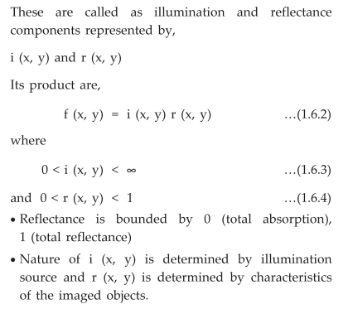
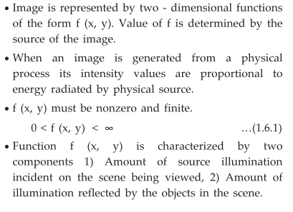
A Simple Image Formation Model

Slide 43
Representing Digital Images
Assume that an image f(x, y) is sampled so that the resulting digital image has M rows and N columns.
The values of the coordinates (x, y) now become discrete quantities.
For example the values of digital image at the origin is f(0, 0).
The next coordinate values along the first row of the image is f(0, 1).
Each element of this matrix array is called an image element, picture element, pixel, or pel.

Slide 44
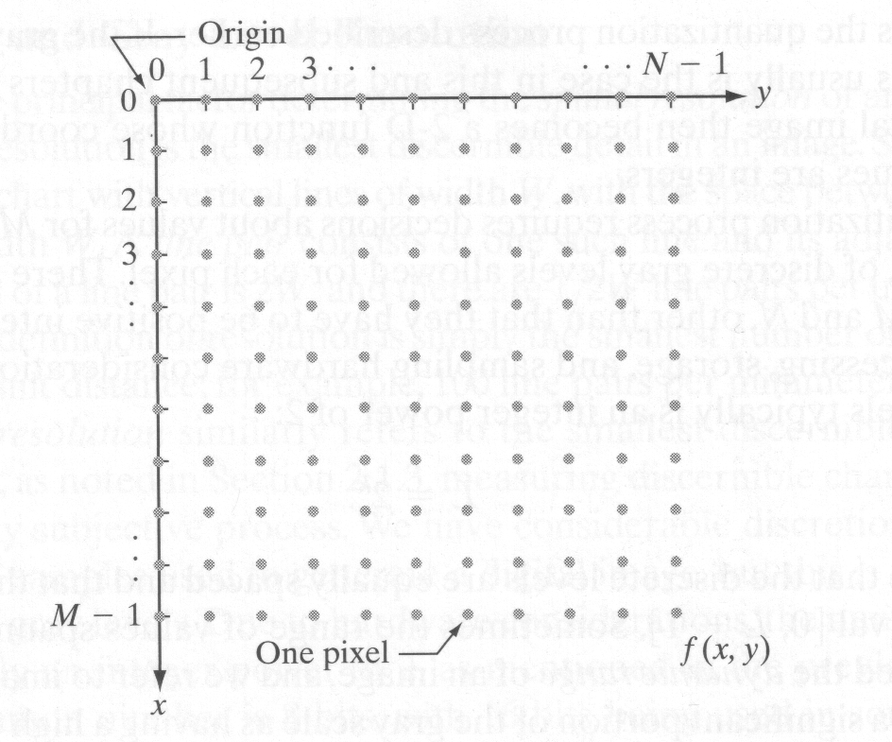
Fig. 3.3. Coordinate convention used to represent digital images

Slide 45
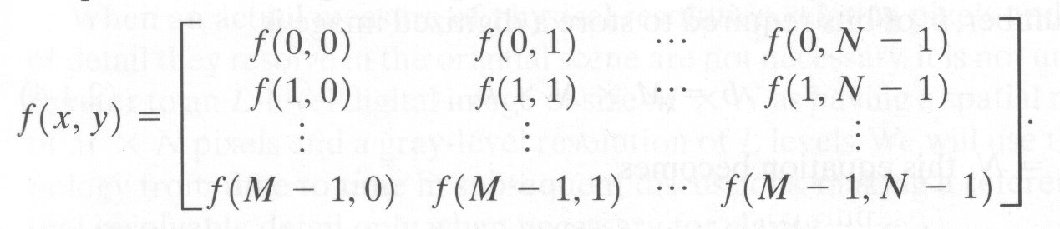
A digital image of size M x N is represented in numerical array as
Fig. 3.4. A digital image of size M x N

Slide 46
The pixel intensity levels (gray-scale levels) are in the interval of [0, L-1].
Where L = 2^{k}
The dynamic range of an image is the range of values spanned by the gray scale.
Another way of defining dynamic range of an imaging system is the ratio of the maximum measurable intensity to the minimum detectable intensity level in the system.
As a rule, the upper limit is determined by saturation and the lower limit by noise.
Contrast, is defined as the difference in intensity between the highest and lowest intensity levels in an image.
When an appreciable number of pixels in an image have a high dynamic range, the we can expect the image to have high contrast.

Slide 47
The number of bits required to store a digitized image is
b = M x N x k
Where M & N are the number of rows and columns, respectively.
If M=N then b = N² k
If the number of gray levels L is an integer power of 2 then
L = 2^{k} where k =1,2,3….
Then the image called as a “k-bit image”

Slide 48
Pixels!
Every pixel has # of bits (k)
Q: Suppose a pixel has 1 bit, how many gray levels can it represent? Answer: 2 intensity levels only, black and white.
Bit (0,1) → 0:black , 1: white
Q: Suppose a pixel has 2 bit, how many gray levels can it represent? Answer: 4 gray intensity levels
2Bit (00, 01, 10 ,11).
Now ..
if we want to represent 256 intensities of grayscale, how many bits do we need?
Answer: 8 bits → which represents: 2⁸=256 so, the gray intensities ( L ) that the pixel can hold, is calculated according to according to number of pixels it has (k). L= 2^{k}

Slide 49
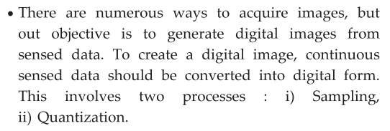
IMAGE SAMPLING AND QUANTIZATION

Slide 50
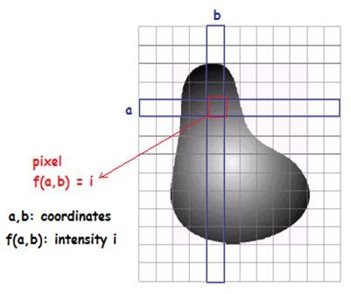
Image sampling and quantization
To convert continuous image (in real life) to digital image (in
computer)
we use Two processes:
1.sampling 2.quantization.
Remember that:
the image is a function f(x,y),
x and y: are coordinates
f: intensity value (Amplitude)
Sampling: digitizing the coordinate values
Quantization: digitizing the amplitude values
Thus, when x, y and f are all finite, discrete quantities, we call the image a digital image.
50

Slide 51
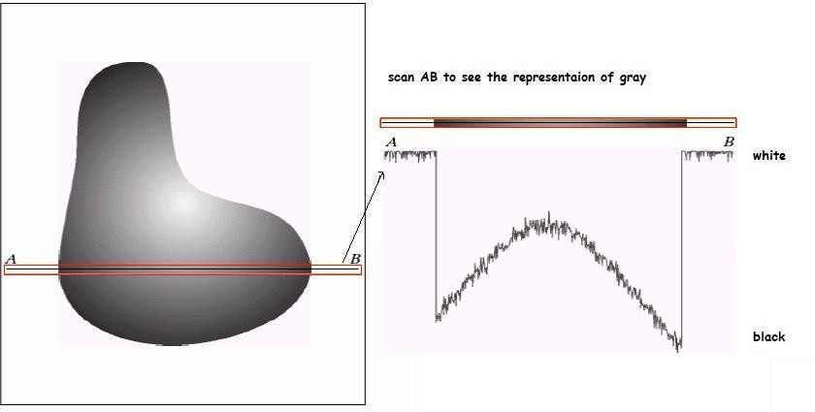
How does the computer digitize the continuous image?
Ex:
scan a line such as AB from the continuous image, and represent
the gray intensities.
51

Slide 52
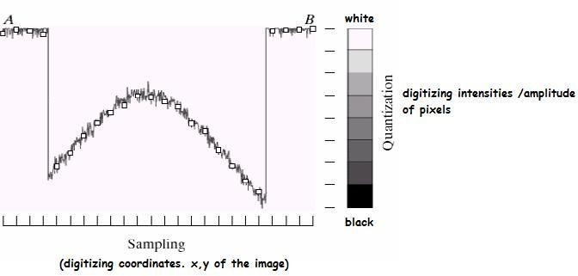
How does the computer digitize the continuous image?
Sampling: digitizing coordinates
Quantization: digitizing intensities
Gray-level scale that divides gray-level into 8 discrete levels
Quantization: converting each sample gray- level value into discrete digital quantity.
sample is a small white square, located by a vertical tick
mark as a point x,y
Hanan Hardan
6

Slide 53
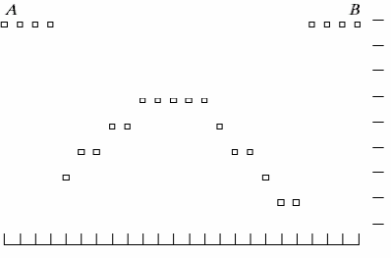
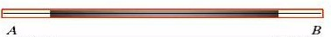
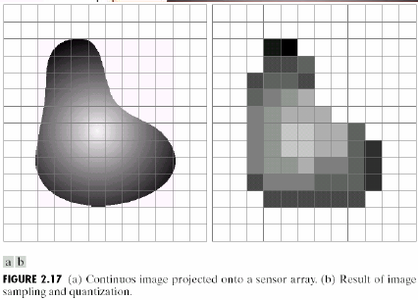
How does the computer digitize the continuous image?
Now:
the digital scanned line AB
representation on computer:
The continuous image VS the result of digital image after sampling and quantization
53

Slide 54
Elements of Visual perception

Slide 55
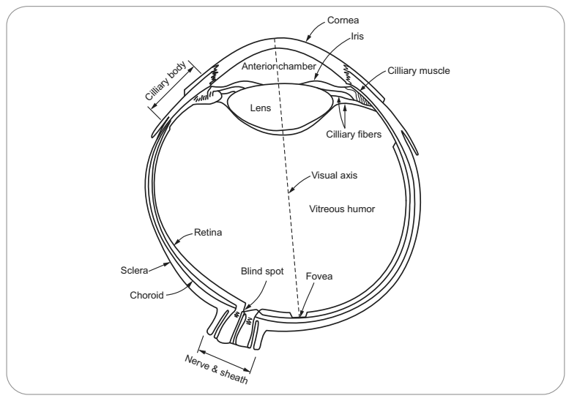
Elements of visual perception-Structure of Eye
The visual system consists of two parts.
1. The eyes act as image receptors.
2. The brain acts as an image processing and interpretation unit.

Slide 56
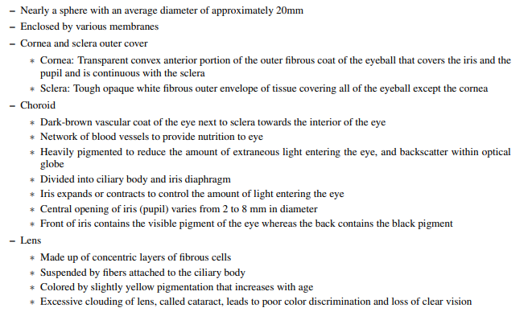
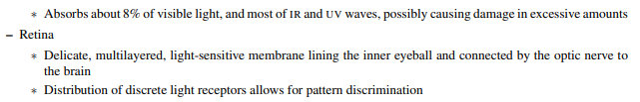

Slide 57
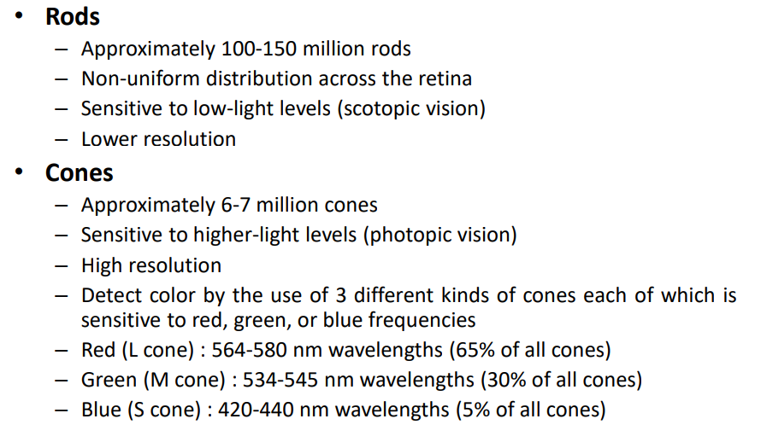

Slide 58
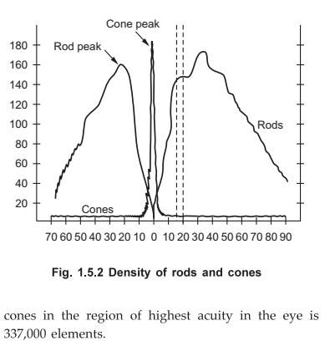
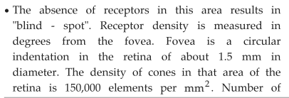
Density of rods and cones

Slide 59
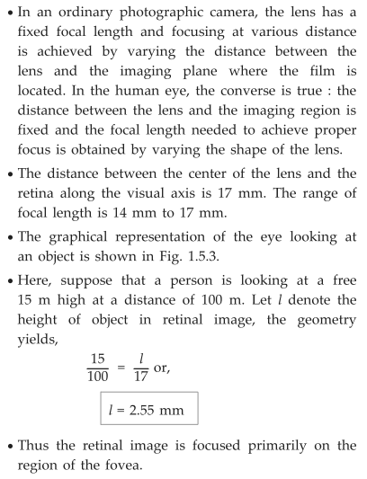
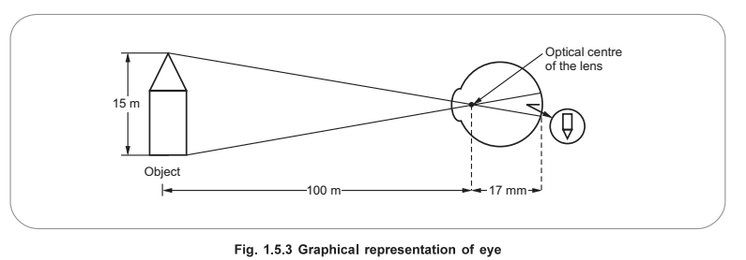
Image formation of eye

Slide 60
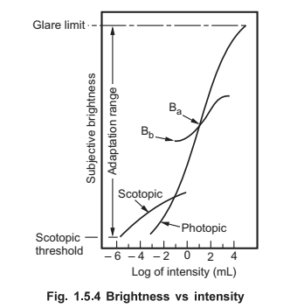
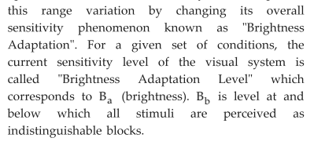
Brightness adaption and Discrimination
It accomplishes

Slide 61
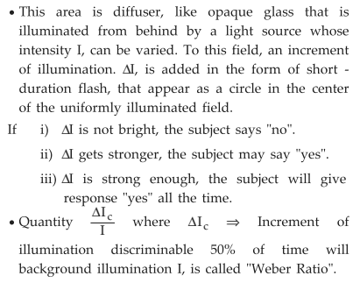
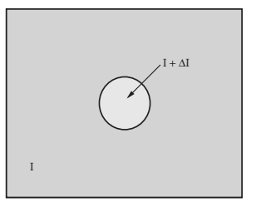
Characterise the brightness discrimination

Slide 62
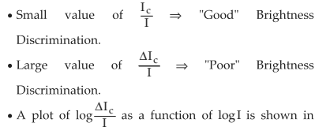
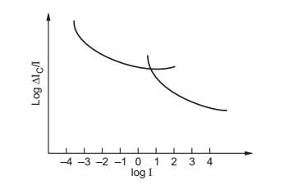
Weber ratio as function of intensity

Slide 63
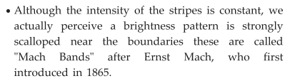
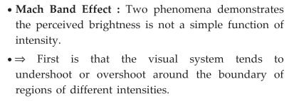
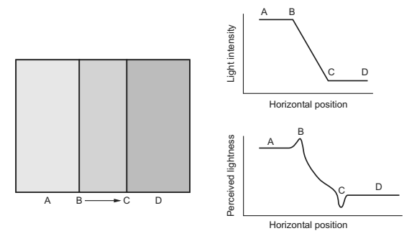
Mach band effect

Slide 64
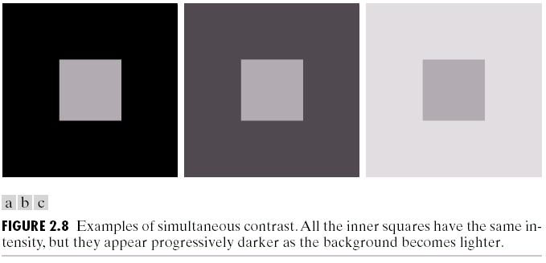
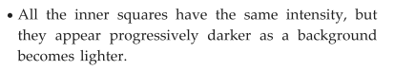
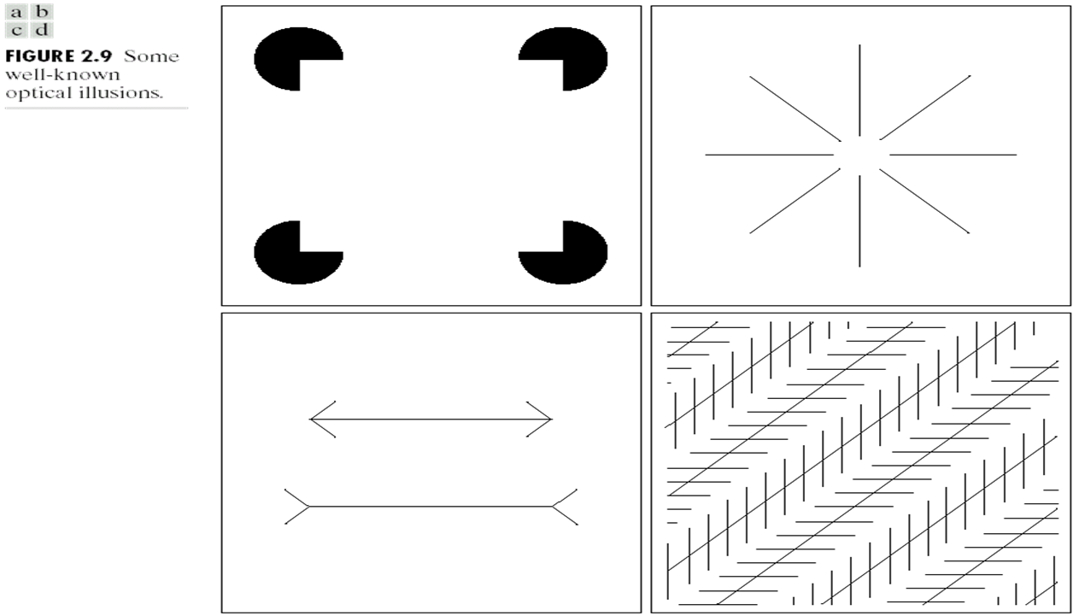

Simultaneous contrast
The second phenomena, called simultaneous contrast, a spot may appears to the eye to become darker as the background gets lighter.
Optical Illusions

Slide 65



Intensity and spatial Resolution
Image interpolation

Slide 66
Colour models

Slide 67

Colour models- Introduction

Slide 68

Colour Models

Slide 69

Colour models- Colour Gamut
Color gamut is defined as the range of colors which a particular device could produce or record. It is usually shown by an enclosed area of the primary colors of the device on the chromaticity diagram.
For example, the primary colors of monitor are red, green and blue; hence, the color gamut of the monitor is shown in a triangle area enclosed by the color coordinates of the monitor red, green and blue colors.
By additivity of colors:
Any color inside the
triangle can be produced
by combinations of the
three initial colors
RGB gamut of
monitors
Color gamut of
printers

Slide 70


Colour models

Slide 71


RGB Model

Slide 72


Slide 73


CMY Model

Slide 74

Ex: Convert RGB to CMY
C= 1-R
M= 1-G
Y= 1-B

Slide 75




HIS Model
The HIS colour model can be considered as a cylinder,
where the coordinates r, θ, and z are saturation,
hue and intensity respectively.

Slide 76


Conversion RGB to HSI

Slide 77
CMYK model
CMYK (Cyan, Magenta, Yellow, Key/Black) is the color space for printed materials. Use a CMYK color profile for any project design that will be physically printed. A printing press creates images by combining these colors to varying degrees with physical ink.
Difference CYMK and RGB : Subtracting cyan, magenta, yellow, and black inks create white – or the original color of the paper or background. RGB color values range from 0 to 255, while CMYK ranges from 0-100%. RGB has a wider range, or gamut, of colors compared to CMYK. CMYK prints cannot reproduce all RGB model colors
Printing uses CMYK comes down to an explanation of the colors themselves. CMY will cover most lighter color ranges quite easily, compared to using RGB. However, CMY by itself can't create very deep dark colors like “true black,” so black

Slide 78



CMYK MODEL
The CMYK color model is a subtractive color model, based on the CMY color model, used in color printing, and is also used to describe the printing process itself.
CMYK refers to the four ink plates used in some color printing: cyan, magenta, yellow, and key.

